Slide 1
293 Unique Users
1,048,575 Data Points
66 Declined
Participation
227 Unique Users
with Data Recorded
74 users with <7 days of data
153 Unique Users
with > 7 days of data
Number of Users by State
Wisconsin
N=92
New York
N=17
Michigan
N=7
Pennsylvania
N=7
Other
N=30

Slide 2
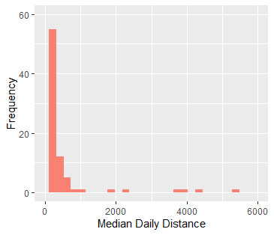
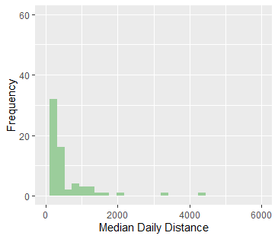
Median Daily Distance Traveled
Weekday
Weekend

Slide 3
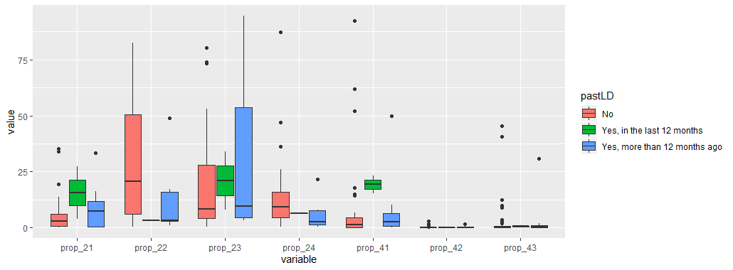
Land Cover Class by Prev. LD

